Slide 1
Sparse Interprocedural Dataflow Analysis
Mingshan March 29

Slide 2
Data Flow Analysis Basics
Precise Interprecedural Dataflow Analysis
Sparse Precise Interprecedural Dataflow Analysis
Notes:
I will first present some basic knowledge about DA, so everyone can better understand the topic, even if you haven’t learned it before.
Then I will talk about the method of precise interprocedural DA presented by Thomas Susan and Mooly in 1995.
In the third party I will introduce the idea of sparse dataflow analysis.

Slide 3
1.Data Flow Analysis Basics
Compiler
Perform analysis based on local information
Data Flow Analysis
Perform a more global analysis
Discover more properties of program by associating an appropriate set of dataflow facts with each program point.
Notes:
Let us begin with the basics of DA, so why do you need DA?
local information: it only examines one or two lines of code separately. Intuitivly, the analysis is only preliminary.
DA in the other hand will perform a more global analysis, and hence can discover more properties of program.
The way of preforming a DA is to associate an appropriate dataflow fact with each program point.

Slide 4
Data Flow Analysis Examples
Constant propagation (must, forward)
Available expressions analysis (must, forward)
Reaching definitions analysis (may, forward)
Uninitialized variables analysis (may, forward)
Live variables analysis (may, backward)
Very busy expressions analysis (must, backward)
.....
Notes:
There are lots of clients in DA .... CARLUV.
I will take Live variables analysis here as an example. Let us see how this is performed in detail.

Slide 5
Live variables analysis
A variable is live at a program point if its current value may be read in the remaining execution.
var x,y,z;
x = input;
while (x>1) {
y = x/2;
if (y>3)
x = x-y;
z = x-4;
if (z>0)
x = x/2;
z = z-1;
}
output x;
Which variables are live at which locations?
Which are not?
→ find out the set of live variables for each point.
Notes:
Let us first look at the definition of live variable:
Let us have a look at the code snippet here.

Slide 6
Lattice
L = (2^{{x,y,z}}, ⊆)
var x,y,z;
x = input;
while (x>1) {
y = x/2;
if (y>3) x = x-y;
z = x-4;
if (z>0) x = x/2;
z = z-1;
}
output x;
trivial answer
{x,y,z}
{x,y}
{y,z}
{x,z}
{x}
{y}
{z}
∅
Notes:
First, we need to find out the lattice of this problem. (space where the result should be in)
2 to the power of all vars,
set of live vars at each point should be a subset of {x, y, z}
trival answer : information we know without analysis: at each point, all vars may be read in. so the trivial answer is set of all vars.
trival answer is T, for all dataflow facts d, T ⌈⌉ d = d. Also, for all dataflow functions, f_{n}(T) = T.
??

Slide 7
control flow graph
x = input
while (x > 1)
y = x/2
if (y > 3)
x = x-y
var x,y,z
z = x-4
z > 0
x = x/2
entry
var x,y,z;
x = input;
while (x>1) {
y = x/2;
if (y>3) x = x-y;
z = x-4;
if (z>0) x = x/2;
z = z-1;
}
output x;
z = z-1
output x
exit

Slide 8
setting up
Let ⟦v⟧ denote the set of variables live before node v (pre-state of v)
Join(v) = ∪ _{w∈ succ(v)} ⟦w⟧
v
w₁
w_{n}
w₂
Notes:
double square brackets: call it live v
pre-state : the dataflow fact we would like to know.
post-state
Join of v: information coming from v’s successive nodes.

Slide 9
constraints
v is exit node:
⟦exit⟧ = Join(v) ∪ ∅ = ∅
v is condition:
⟦if (E)⟧ = ⟦while(E)⟧ = Join(v) ∪ vars(E)
v is output:
⟦output E⟧ = join(v) ∪ vars(E)
v is assignment:
⟦x = E⟧ = (join(v) \ {x}) ∪ vars(E)
v is variable declaration:
⟦var x₁, ..., x_{n} ⟧ = join(v) \ {x₁, ..., x_{n} }
v is other node:
⟦v⟧ = join(v)
var(E) = variables occurring (being read) in E
right hand side of each equation is monotonic
Notes:
contraints or transfer function at each kind of node (the effect before the execution of this node)
monotonic: because join is monotonic → we can compute the fixed point

Slide 10
computing (least) fixed point
⟦exit⟧ = ∅
⟦output x⟧ = ⟦exit⟧ ∪ {x}
⟦z = z - 1⟧ = (⟦output x⟧ ∪ ⟦ while(x > 1) ⟧ \ {z}) ∪ {z}
⟦x = x/2⟧ = (⟦z = z - 1⟧ \ {x}) ∪ {x}
⟦if(z > 0)⟧ = ⟦z = z - 1⟧ ∪ ⟦x = x/2⟧ ∪ {z}
⟦z = x - 4⟧ = (⟦if(z > 0)⟧ \ {z}) ∪ {x}
⟦x = x - y⟧ = (⟦z = x - 4⟧ \ {x}) ∪ {x, y}
⟦if(y > 3)⟧ = ⟦z = x - 4⟧ ∪ ⟦x = x - y⟧ ∪ {y}
⟦y = x/2⟧ = (⟦if(y > 3)⟧ \ {y}) ∪ {x}
⟦while(x > 1)⟧ = ⟦output x⟧ ∪ ⟦y = x/2⟧ ∪ {x}
⟦x = input⟧ = ⟦while(x > 1)⟧ \ {x}
⟦var x, y, z⟧ = ⟦x = input⟧ \ {x, y, z}
⟦entry⟧ = ⟦var x, y, z⟧
= {x}
⟦while(x > 1)⟧ = {x, y, z} //initialized to T
= {x, z}
= {x, z}
var x,y,z;
x = input;
while (x>1) {
y = x/2;
if (y>3) x = x-y;
z = x-4;
if (z>0) x = x/2;
z = z-1;
}
output x;
= {x, z}
= {x}
= {x, y}
= {x, y}
= {x}
= {x}
= ∅
Many non-trivial answer!
= ∅
= ∅
Notes:
⟦x > 1⟧ = {x, y ,z} using pen to calculate, then show the orange result

Slide 11
optimization based on analysis
y and z are never simultaneously live
- they can share the same variable location
z = z - 1 is never read
- the assignment can be skipped
var x,y,z;
x = input;
while (x>1) {
y = x/2;
if (y>3) x = x-y;
z = x-4;
if (z>0) x = x/2;
z = z-1;
}
output x;
var x,yz;
x = input;
while (x>1) {
yz = x/2;
if (yz>3) x = x-yz;
yz = x-4;
if (yz>0) x = x/2;
}
output x;
Notes:
z = z - 1 is never read ?
check solutions of successive nodes of z = z - 1

Slide 12
two kinds of problems
Forward problems：the information at node N is based on the information of all its previous nodes.
- examples: Constant propagation, Reaching definitions
Backward problems： the information at node N is based on the information of all its successive nodes.
- examples: Very busy expressions analysis

Slide 13
May vs. must
A may analysis (set union at join)
- describes information that is possibly true
- an over-approximation
- examples: live variables, reaching definitions
A must analysis (set intersection at join)
- describes information that is definitely true
- an under-approximation
- examples: available expressions, very busy expressions

Slide 14
2. Precise interprocedural analysis via graph reachability
To find precise solutions to a large class of interprocedural dataflow-analysis problems in polynomial time.
‘precise’ means providing ‘meet-over-all-valid-paths’ solution. (context-sensitive)
‘a large class’ consists of all problems in which the set of dataflow facts D is a finite set and the dataflow functions (which are in 2^{D} → 2^{D}) distribute over the confluence operator (either union or intersection, depending on the problem).
→ IFDS problems : interprocedural, finite, distributive, subset problems
A function f: L → L is distributive iff for all x,y in L: f(x meet y) = f(x) meet f(y).

Slide 15
IFDS Framework
A program is represented using a directed graph G * = (N * , E * ) called a supergraph.
G* consists of a collection of control flow graphs G1,G2, . . . (one for each procedure), one of which, G_{main}, represents the program’s main procedure.
Each flowgraph G_{p} has a unique start node s_{p}, and a unique exit node e_{p}.
A procedure call is represented by two nodes, a call node and a return-site node.
Other nodes of the flowgraph represent the statements and predicates of the procedure in the usual way.
enter P
1
enter P
s_{p}
1
2
2
call P;
P(a);
ret P;
4
3
3
exit P
e_{p}
exit P
4
Notes:
For the convenience of analysis, procedural call is represented by two nodes, call node and return node

Slide 16
Edges in supergraph
For each procedure call, represented by call-node c and return-site node r,
G * has three edges:
An interprocedural call-to-start edge from c to the start node of the called procedure;
An interprocedural exit-to-return-site edge from the exit node of the called procedure to r.
An intraprocedural call-to-return-site edge from c to r; The call-to-return-site edges are included so that the IFDS framework can handle programs with local variables.
1
2
enter P
s_{p}
call P;
ret P;
3
exit P
e_{p}
4
Notes:
two incoming edges of ret P : call-to-return edge, exit-to-return edge. first is to handle local vars, second is to handle global vars

Slide 17
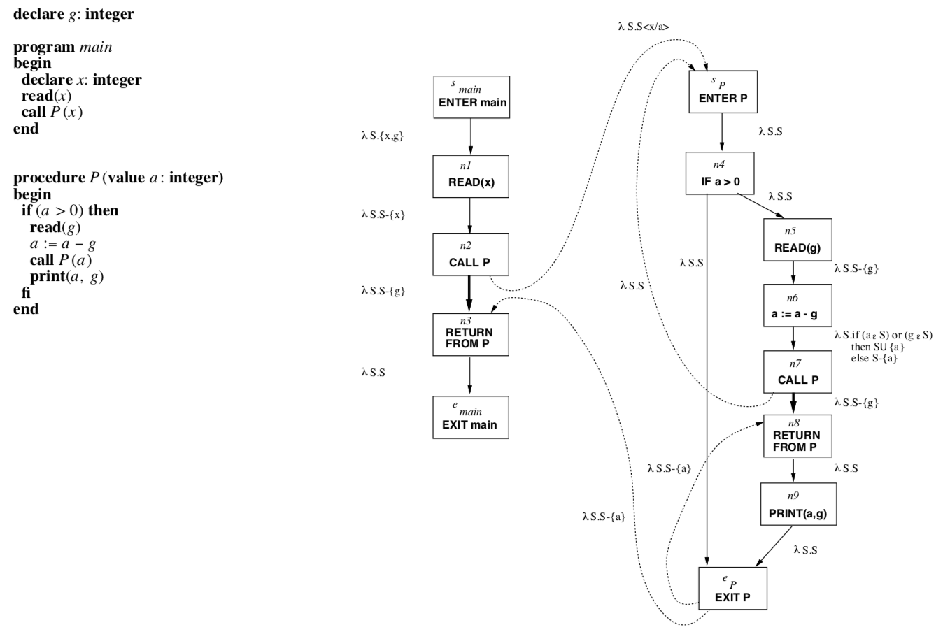
global var g;
void main(){
var x;
x = input;
P(x);
}
void P(x){
if (a > 0){
g = input;
a = a – g;
P(a);
print(a, g);
}
}
[S_{main} → n₁, n₁→ n₂, n₂→s_{p}, s_{p}→n₄, n₄→e_{p}, e_{p}→n₃]
Valid
[S_{main} → n₁, n₁ → n₂, n₂ → s_{p}, s_{p} → n₄, n₄ → e_{p}, e_{p} → n₈]
Invalid

Slide 18
An instance IP of IFDS problem
IP = (G , D, F, M, ⌈ ⌉)
G* is a supergraph as defined above.
D is a finite set.
F ⊆ 2^{D} → 2^{D} is a set of distributive functions.
M: E* → F is a map from G*’s edges to dataflow functions.
The meet operator is either union or intersection.

Slide 19

MVP solution to IP
Let IP = (G*, D, F, M, ⌈ ⌉) be an IFDS problem instance. The meet-over-all-valid-paths solution to IP consists of the collection of values MVP_{n} defined as follows:
Notes:
q here is a non-empty path in G*
IVP: interprecedural valid path

Slide 20
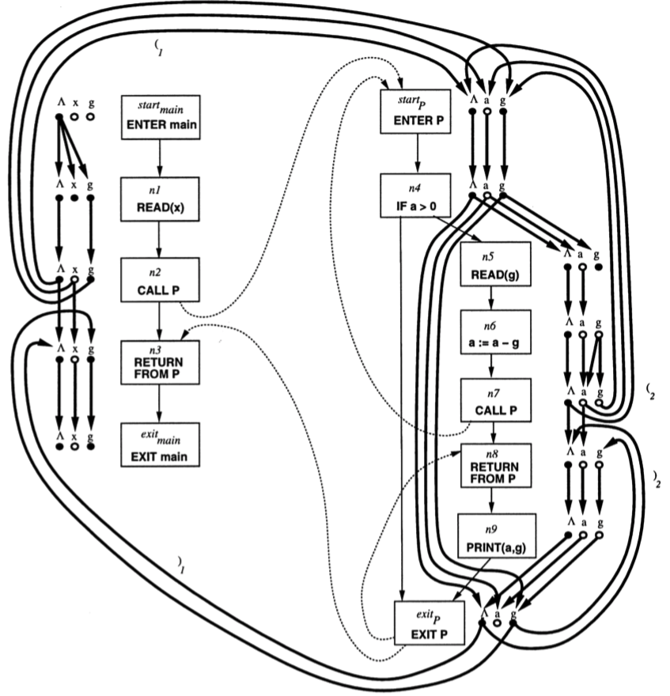
IFDS Problems
Realizable-path
graph-reachability problems
Notes:
valid path is in G* supergraph
realizable path is in G# exploded graph

Slide 21
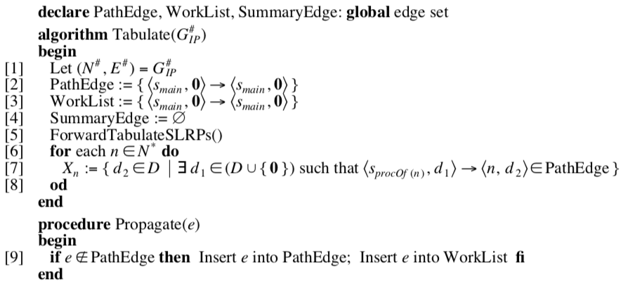
tabulation algorithm

Slide 22
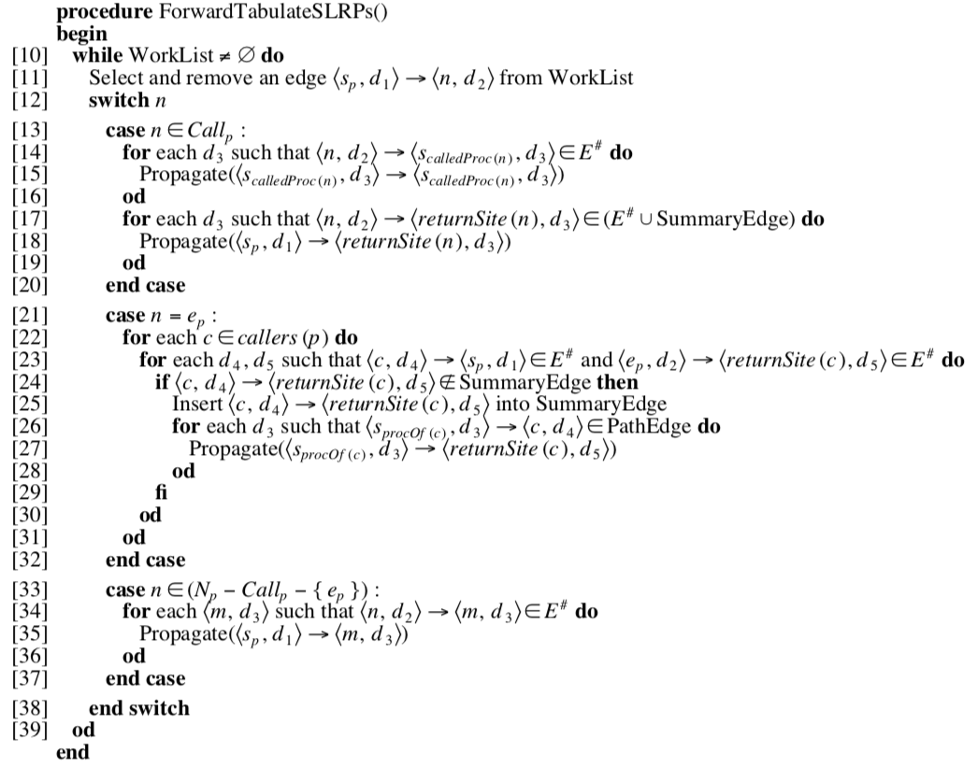
Notes:
The tabulation algorithm is a worklist algorithm that accumulates sets of path edges and summary edges. The initial set of path edges represents the 0-length path from <s_main,0> to <s_main, 0>. On each iteration of the main loop, in procedural ForwardTabulate, the algorithm deduces the existence of additional path edges and summary edges.

Slide 23
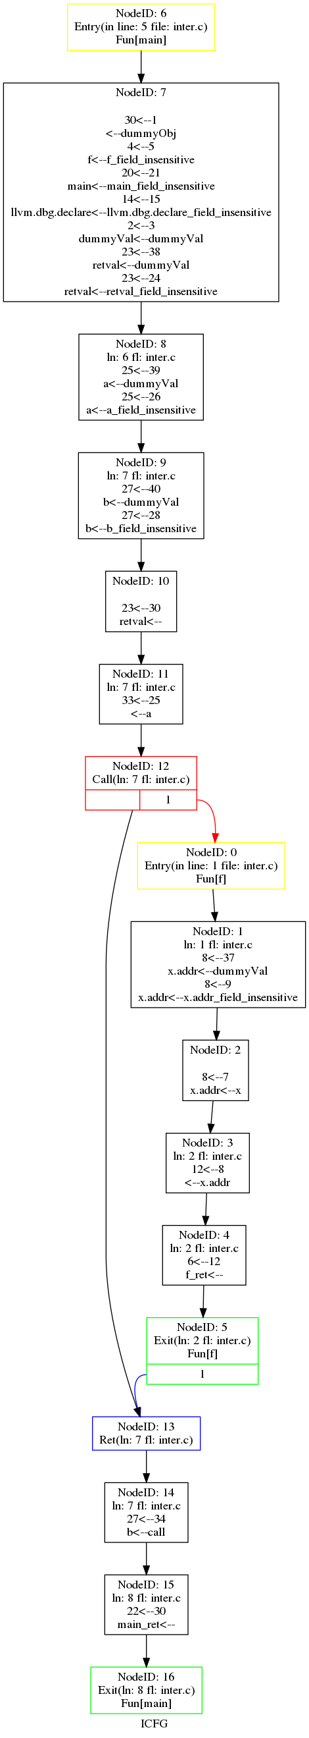
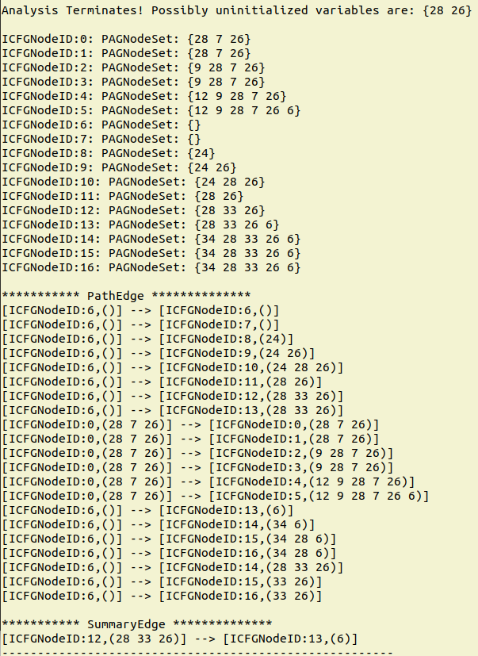
int f(int x){
return x;
}
int main(){
int a;
int b = f(a);
return 0;
}
Notes:
implementation in svf

Slide 24
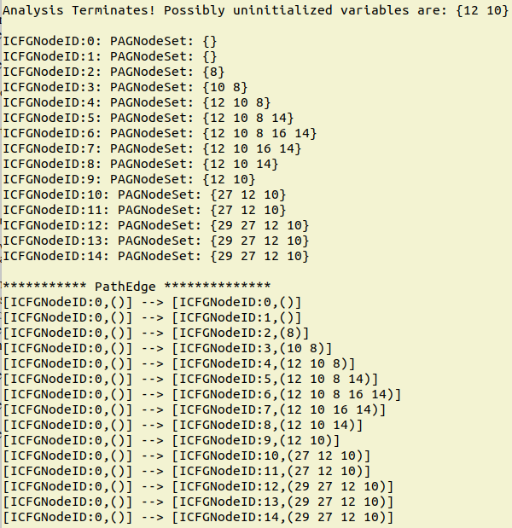
3. make it Sparse
int main(){
int a;
int b;
int c;
int d;
d = 3;
c = 2;
b = a + d;
return 0;
}
Notes:
Traditional Dataflow analysis is based on Control Flow Graph, dataflow fact is propagated along CFG, which means under most circumstances, it goes to nodes where it won’t be used. We instead use Value Flow Graph to analysis, dataflow fact is only propagated to where it will be used, thus make the analysis much more time and space efficient.

Slide 25
Control flow vs. value flow
var x = 1;
print(x);
if (z > 0)
var x := 2;
print(x);
Notes:
value flow graph (def-use graph)

Slide 26
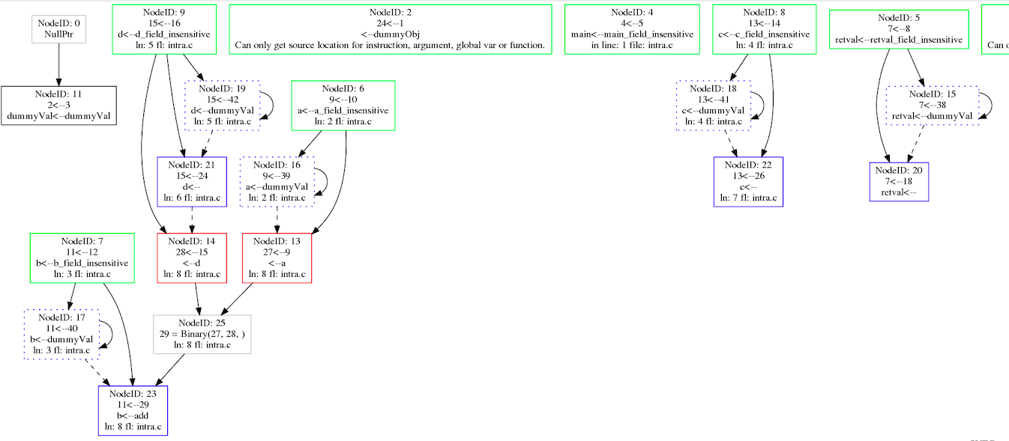
int main(){
int a;
int b;
int c;
int d;
d = 3;
c = 2;
b = a + d;
return 0;
}

Slide 27
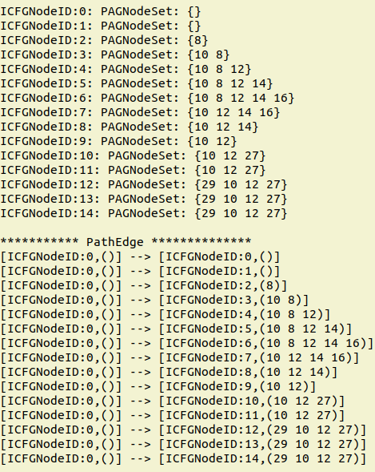
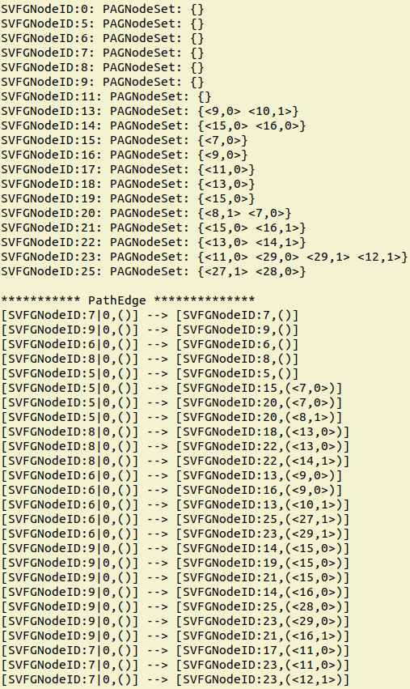
Dataflow fact is propagated along CFG
Sparse Precise Interprocedural
Dataflow Analysis
Dataflow fact is only propagated to where it will be used
Notes:
Traditional Dataflow analysis is based on Control Flow Graph, dataflow fact is propagated along CFG, which means under most circumstances, it goes to nodes where it won’t be used. We instead use Value Flow Graph to analysis, dataflow fact is only propagated to where it will be used, thus make the analysis much more time and space efficient.

